Slide 1

GROUP 1
A group presentation by: ABHIJEET SHAH
ABHINAV VYAS
ADITI CHAUHAN
ADITYA DOBRIYAL
ADITYA GAIROLA
ADITYA RAWAT
ADITYA SINGH
ADITYA RAWAT

Slide 2

CITIZEN AMENDMENT ACT
An analysis of the Act, its provisions, and the key constitutional and political issues it raises in India.

Slide 3





What is the CAA, 2019?
Amends Citizenship Act, 1955
Grants a path to Indian citizenship for specific groups of illegal migrants.
Eligible Groups
Applies to Hindus, Sikhs, Buddhists, Jains, Parsis, and Christians.
Origin and Cut-off
Must be from Pakistan, Bangladesh, or Afghanistan, having entered India before December 31, 2014.
Relaxed Naturalization
Mandatory continuous stay for naturalization reduced from 11 years to just 5 years for these groups.

Slide 4

The Principle of Religious Exclusion
Challenge to Secularism
Critics argue the Act violates the fundamental principle of secularism enshrined in the Indian Constitution, particularly Article 14 (Right to Equality).
The Act specifically excludes Muslims from the list of persecuted minorities eligible for fast-track citizenship.
The rationale is disputed, as it ignores persecuted Muslim sects (e.g., Shias, Ahmadiyyas) and non-religious minorities in the three countries.

Slide 5
Selective Focus on Three Nations
Geographic Limit
Exclusions Not Covered
Questionable Objective
The CAA focuses only on Pakistan, Bangladesh, and Afghanistan, omitting other neighbouring countries with severe persecution issues.
Countries like Sri Lanka (Tamil refugees) and Myanmar (Rohingya Muslims) are not covered by the Act.
This selectivity raises questions about whether the Act's primary objective is humanitarian aid or a political/geopolitical agenda.
The humanitarian crisis extends beyond the three specified nations, leading to concerns about the Act's scope.

Slide 6

Violation of Article 14 (Right to Equality)
Arbitrary Classification
Is religion a reasonable classification?
Rational Nexus
Connection between class and legislative aim
Legal Precedent
Court rulings on Article 14 tests

Slide 7


Threat to Indigenous Culture in the Northeast
Demographic Anxiety
States like Assam fear the CAA will legalize a huge influx of migrants, altering the indigenous demographic and cultural identity.
The CAA overrides the cut-off date of March 24, 1971, set by the Assam Accord (1985) for detecting illegal immigrants.
While tribal areas and regions under the Inner Line Permit (ILP) are exempt, the fear of cultural dilution in non-exempt regions remains strong.

Slide 8
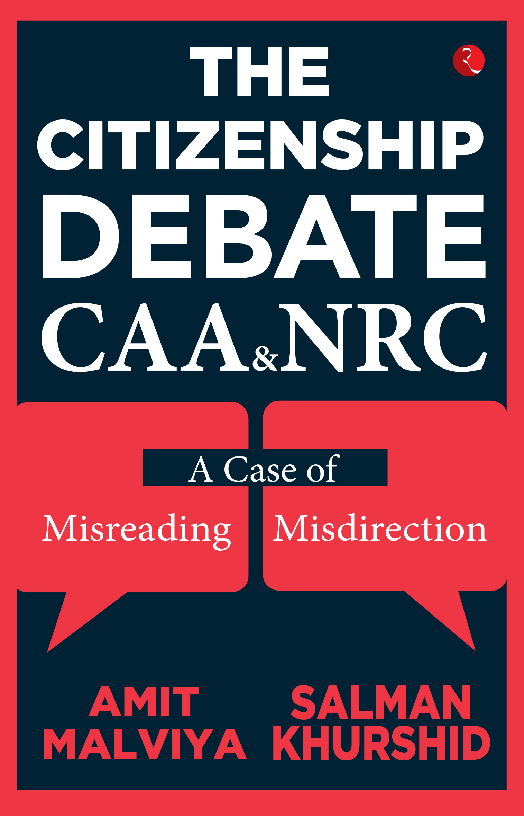
CAA and the National Register of Citizens (NRC)
The CAA is often viewed in conjunction with a potential nationwide NRC, creating a combined fear among certain communities.
Potential NRC
A nationwide NRC could potentially declare many people non-citizens if they cannot provide required documentation.
CAA as Safety Net
The CAA then allows all non-Muslim non-citizens to become citizens via fast-track naturalization.
Exclusion for Muslims
Muslims declared non-citizens by the NRC will not have this safety net provided by the CAA, leading to statelessness concerns.

Slide 9


Solution
Amend the CAA
Comprehensive Asylum Law
Remove the religious criterion and make the law religion-neutral. Grant citizenship based purely on verifiable persecution, irrespective of faith.
Enact a clear, comprehensive national asylum and refugee policy that aligns with international conventions and humanitarian principles.

Slide 10











Summary of Key Challenges
The CAA presents complex legal, social, and constitutional challenges that require careful consideration and dialogue.
Article 14
Religious Bias
Violation of the Right to Equality due to arbitrary classification.
Exclusion of one community challenges secular ethos.
Geographic Scope
Selective focus ignores persecution in other neighbouring countries.
NRC Link
Combined effect creates fear of statelessness for Muslims.
Cultural Dilution
Fear of demographic change in Northeast states.

Slide 11

Thank You
We appreciate your attention and engagement on this critical national issue.

